Slide 1



CSE 326 : UNIT-2
Supervised by
SUSHIL LEKHI
(Assistant Professor)
Department of Computer Science & Engineering
LOVELY PROFESSIONAL UNIVERSITY PUNJAB December, 2019

Slide 2
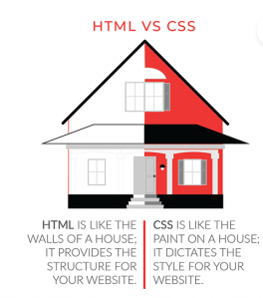
HTML Formatting Elements
Formatting elements were designed to display special types of text:
<b> - Bold text
<strong> - Important text
<i> - Italic text
<em> - Emphasized text
<mark> - Marked text
<small> - Smaller text
<del> - Deleted text
<ins> - Inserted text
<sub> - Subscript text
<sup> - Superscript text

Slide 3

HTML <b> and <strong> Elements
The HTML <b> element defines bold text, without any extra importance.
<b>This text is bold</b>
The HTML <strong> element defines text with strong importance. The content inside is typically displayed in bold.
<strong>This text is important!</strong>

Slide 4
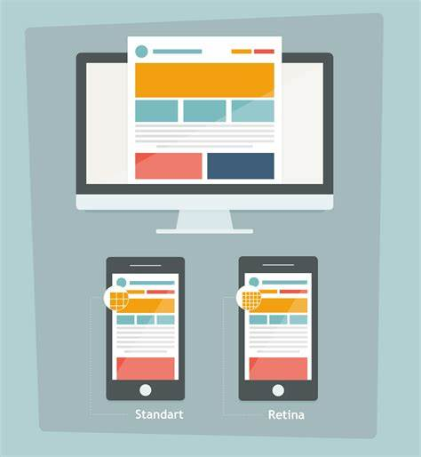
HTML <i> and <em> Elements
The HTML <i> element defines a part of text in an alternate voice or mood. The content inside is typically displayed in italic.
Tip: The <i> tag is often used to indicate a technical term, a phrase from another language, a thought, a ship name, etc.
<i>This text is italic</i>
The HTML <em> element defines emphasized text. The content inside is typically displayed in italic.
Tip: A screen reader will pronounce the words in <em> with an emphasis, using verbal stress.

Slide 5
HTML <small> and <mark> Element
The HTML <small> element defines smaller text:
<small>This is some smaller text.</small>
HTML <mark> Element
The HTML <mark> element defines text that should be marked or highlighted:
<p>Do not forget to buy <mark>milk</mark> today.</p>

Slide 6
HTML <del> and <ins> Element
The HTML <del> element defines text that has been deleted from a document. Browsers will usually strike a line through deleted text:
<p>My favorite color is <del>blue</del> red.</p>
HTML <ins> Element
The HTML <ins> element defines a text that has been inserted into a document. Browsers will usually underline inserted text:
<p>My favorite color is <del>blue</del> <ins>red</ins>.</p>

Slide 7
HTML <sub> and <sup> Element
The HTML <sub> element defines subscript text. Subscript text appears half a character below the normal line, and is sometimes rendered in a smaller font. Subscript text can be used for chemical formulas, like H2O:
<p>This is <sub>subscripted</sub> text.</p>
HTML <sup> Element
The HTML <sup> element defines superscript text. Superscript text appears half a character above the normal line, and is sometimes rendered in a smaller font. Superscript text can be used for footnotes, like WWW[1]:
<p>This is <sup>superscripted</sup> text.</p>

Slide 8
Formatting text with HTML logical style elements
in HTML, the logical style tags specify that the enclosed text has a specific meaning, context, or usage.
For example, the ABBR tag conveys to the Web browser that the text enclosed inside this tag is an abbreviation. The browser change the appearance of the text depending upon the meaning of the tags.
The advantage of using the logical style tags rather than the physical style tags is that the meaning related to the tag is more precisely conveyed to the users

Slide 9
Formatting text with HTML logical style elements
Tag | Description
ABBR | Displays the abbreviation on the Web page
CODE | Refers to the program code
SAMP | Displays the sample program output on the Web page
KBD | Refers to the keyboard keys
EM | Emphasized text
STRONG | Emphasized text by increasing boldness
DFN | Displays new terms on the Web page
Q | Displays the short quotations on the Web page
BLOCKQUOTE | Displays the long quotations on the Web page
INS | Displays the inserted text
DEL | Displays the deleted text
VAR | Represent a variable
BDO | Changes the direction of text

Slide 10
Creating links with anchor tag
The primary purpose of an anchor tag is to link one page to another page or to a section of the same page. The anchor tag is also known as a HyperLink. Like any other HTML tags, you use the following construct to create an anchor tag:
<a>My Website</a>
The above anchor tag is a valid HTML tag, but it doesn't do much other than act as a placeholder.

Slide 11
Creating links with hyperlink and email
<a href="https://www.google.com/">My Website</a>
The value of the href attribute is usually a URL pointing to a web page (like the one above).
How to link to an email client
<a href="mailto:me@example.com">Send email</a>
Similarly, you can use the tel:<Phone Number> construct to open up the default phone app with the phone number when someone clicks on the link.

Slide 12
Creating links with mobile number and javascript
<a href="tel:+914123456765">Call +914123456765</a>
How to link to a script and execute it
<a href="javascript:alert('Hello World!')">Click me</a>

Slide 13
Multimedia- audio
Multimedia is almost anything you can hear or see (e.g. sound, music, images, records, videos, films, animations, etc.).
It comes in different formats. Web pages can contain multimedia elements of different formats and types.

Slide 14
Multimedia Tags
HTML allows adding different multimedia files on your website by various multimedia tags. These tags include:
<audio> for displaying a audio file on the web page,
<video> for displaying a video file on the web page,
<embed> for embedding multimedia files on the web page,
<object> for embedding multimedia files on the web page.
<iframe> for embedding other web pages.

Slide 15
Audio Formats
• The newest format for compressed recorded music is MP3. This term is synonymous with digital music.
• MP3 is a good choice if your website is about recorded music. Only WAV, MP3, and Ogg audio formats are supported by the HTML5 standard.
Format | File | Description
MIDI (Musical Instrument Digital Interface). | .mid .midi | This is the main format for all electronic music devices (e.g. synthesizers and PC sound cards). MIDI files contain digital notes that can be played by electronics, but they do not include sound. It plays well on music hardware and computers, but not in web browsers.

Slide 16
Audio Formats
RealAudio | .rm .ram | Allows streaming of audio with low bandwidths. In web browsers, it does not play.
WMA | .wma | This format has been developed by Microsoft and is usually used in music players. It plays well on Windows computers, but not in web browsers.
AAC | .aac | This format has been developed by Apple as the default format for iTunes. It plays well on Apple computers, but not in web browsers.
WAV | .wav | This format has been developed by IBM and Microsoft. It plays well on Windows, Linux, and Macintosh operating systems. Supported by HTML5.

Slide 17
Audio Formats
Ogg | .ogg | This format has been developed by the Xiph.Org Foundation. Supported by HTML5.
MP3 | .mp3 | This is the most popular format for music players. The format has good compression (small files) and high quality. Supported by all browsers.
MP4 | .mp4 | This is a video format but can be used for audio as well. MP4 video is the future video format on the internet leading to automatic support for MP4 audio by all browsers.

Slide 18
HTML <video> Tag
<video width="320" height="240" controls>
<source src="movie.mp4" type="video/mp4">
<source src="movie.ogg" type="video/ogg">
Your browser does not support the video tag.
</video>

Slide 19
Attributes of HTML Video Tag
Attribute | Description
controls | It defines the video controls which is displayed with play/pause buttons.
height | It is used to set the height of the video player.
width | It is used to set the width of the video player.
poster | It specifies the image which is displayed on the screen when the video is not played.

Slide 20
Attributes of HTML Video Tag
autoplay | It specifies that the video will start playing as soon as it is ready.
loop | It specifies that the video file will start over again, every time when it is completed.
muted | It is used to mute the video output.
preload | It specifies the author view to upload video file when the page loads.
src | It specifies the source URL of the video file.

Slide 21
HTML Video Tag Attribute Example
Let's see the example of video tag in HTML where are using height, width, autoplay, controls and loop attributes.
1. <video width="320" height="240" controls autoplay loop>
2. <source src="movie.mp4" type="video/mp4">
3. Your browser does not support the html video tag.
4. </video>

Slide 22
Working with images in a web page
The HTML <img> tag is used to embed an image in a web page.
Images are not technically inserted into a web page; images are linked to web pages. The <img> tag creates a holding space for the referenced image.
The <img> tag is empty, it contains attributes only, and does not have a closing tag.
The <img> tag has two required attributes:
• src - Specifies the path to the image
• alt - Specifies an alternate text for the image

Slide 23
Working with images in a web page
<img src="img_chania.jpg" alt="Flowers in Chania">
Image Size - Width and Height
You can use the style attribute to specify the width and height of an image.
Example
<img src="img_girl.jpg" alt="Girl in a jacket" style="width:500px;height:600px;">
<img src="img_girl.jpg" alt="Girl in a jacket" width="500" height="600">
The width, height, and style attributes are all valid in HTML.

Slide 24
Working with images in a web page
However, we suggest using the style attribute. It prevents styles sheets from changing the size of images:
<html> <head> <style> img { width: 100%; } </style> </head> <body> <img src="html5.gif" alt="HTML5 Icon" width="128" height="128"> <img src="html5.gif" alt="HTML5 Icon" style="width:128px;height:128px;"> </body> </html>

Slide 25
Questions
How to create a hyperlink in HTML?
How to make a picture of a background image of a web page?
What is the use of a span tag? Give one example.
What is the use of an iframe tag?
Which type of video formats are supported by HTML5?
What is an Anchor tag in HTML?
Why is the Embed Tag Used in HTML?

Slide 26
Thank You

